Slide 1

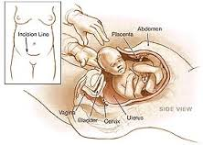

KELOMPOK BERESIKO TINGGI
dalam KEHAMILAN
By. Yuanita W, S. Kep., Ns., MS

Slide 2
OUTLINES
Review KEHAMILAN
Kehamilan pada Remaja
Kehamilan pada Usia Tua
Kehamilan dengan Obesity

Slide 3
KEHAMILAN
FERTILIZATION
FETUS DEVELOPMENT
(9 MONTHS IN THE WOMB)

Slide 4
TANDA & GEJALA KEHAMILAN

Slide 5
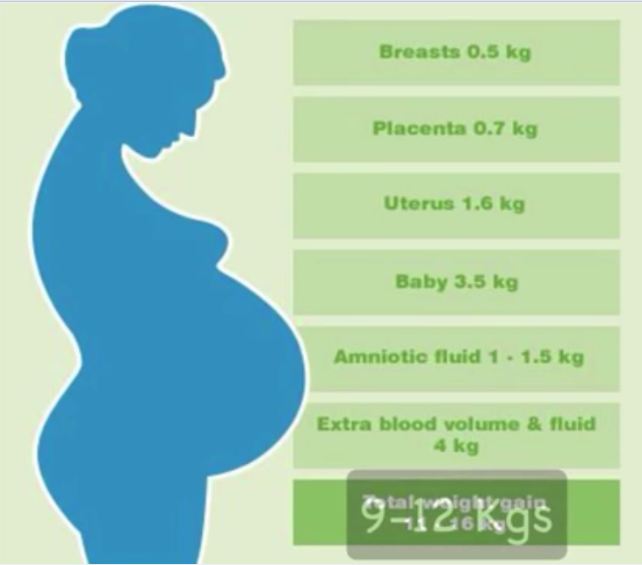
ADAPTASI FISIOLOGIS KEHAMILAN
1
2

Slide 6
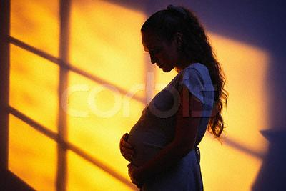
REMAJA
WHO: 12-18 tahun
BKKBN: 10-21 tahun
20% penduduk indonesia adalah remaja (2013)
Masa transisi dari anak-anak menjadi orang dewasa.
Perubahan fisik sedang terjadi bersamaan dengan identitas seksual.
Psikologis: masa pencarian identitas diri, keinginan untuk bebas, kebebasan untuk berpikir dan bertindak.

Slide 7
KARAKTERISTIK IBU MUDA
DATA DUNIA
Low level of education,
Rural dwelling,
Low income.
Source: Growing up global: The Changing Transitions to Adulthood in Developing Countries (National Research Council, 2005).

Slide 8
More than 1/5 of women in the poorest regions have a child by age 18.
Source: Tabulations of demographic & health surveys from 51 countries,1990-2001. (National Research Council, Growing up global: The Changing Transitions to Adulthood in Developing Countries, 2005).
Notes:
8
Overall one if five women in the world have a child by the age of 18. The figure ranges from just over 10% in West Asia and North Africa to just over 30% in West and Middle Africa.

Slide 9
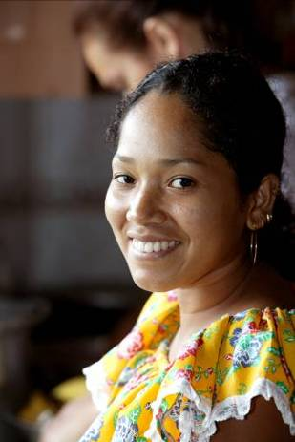
Greater likelihood of maternal mortality
The risk of dying from pregnancy-related causes is twice as high for adolescents aged 15-19, as for older women.
Source: Safe Motherhood Initiative Factsheet, 1998.
Adolescent Sexuality & Childbearing.
Notes:
Child birth at an early age is associated with great health risks for the mother.
The risk of dying from pregnancy-related causes is twice as high for adolescents aged 15-19 as for older women.
The factors contributing to this are:
Giving birth for the first time
Lower social status
Lower economic status
Poor access to health services
Between the ages of 15-19, age may not be the decisive factor but below the age of 15, there are risks associated with the fact that the pregnant girl is not fully developed. Some estimates suggests that for girls aged 101-14, the risk of dying may be 5 times higher than for women in their twenties.

Slide 10
KEHAMILAN PADA REMAJA (KR)
Angka kejadian:
Di Indonesia, 3, 006 respondent remaja (17-24 tahun) 20.9% hamil diluar nikah dan melahirkan sebelum menikah (Penelitian Australian National University - Universitas Indonesia, 2011).
BKKBN (2006), kehamilan remaja diluar nikah
  2,3% karena diperkosa
  8.5% karena sama-sama mau yang direncanakan
  39% karena sama-sama mau yang di tidak rencanakan
  18.5% karena seks bebas
BKKBN (2010), kehamilan remaja diluar nikah
  3,2% karena diperkosa
  12.9% karena sama-sama mau yang direncanakan
  45% karena sama-sama mau yang di tidak rencanakan
  22.6% karena seks bebas
KEHAMILAN YANG TIDAK DIINGINKAN/TIDAK DIRENCANAKAN/DILUAR PERNIKAHAN

Slide 11
FAKTOR YANG TERKAIT dengan KR
Usia pertama haid terlalu dini.
Peer pressure terkait aktivitas seksual.
Riwayat sexual abuse.
Minimnya pengetahuan mengenai kontrasepsi.
Merasa sudah “independen & fredom”.
Kemiskinan.
Budaya.
Kurangnya “role model” yang baik.
Penggunaan obat-obatan dan alkohol.
Situasi rumah yang tidak baik “broken home”.
Early dating tanpa pantuan yang baik.
(Alan Gittmacher Institude, 2012)

Slide 12

DAMPAK KR (1)
Putus sekolah: kemampuan finansial sebagai orang tua
Ketidak siapan emosional & psikologis:
  Pertumbuhan tanpa kehadiran ayah
  Bayi lahir dengan BB rendah atau kematian neonatus
  Perawatan kesehatan yang tidak memadai
  Resiko penelantaran & pembuangan anak
  Resiko kematian ibu hamil dibandingkan ibu hamil usia 20-24 tahun:
  usia 10-14 tahun 5 x lebih tinggi
  usia 15-19 tahun 2 x lebih tinggi

Slide 13
Clinical causes of maternal mortality among adolescents – 1/3
Unsafe abortion¹
  Study from a teaching hospital in Nigeria (over a 10 year period) – abortion was the cause of 36.9% of maternal deaths in 10-19 year olds
Obstructed labour²
  Strong indications of higher risk in mothers below16 years since pelvis is still not fully developed
    Many studies use caesarean section incidence as a proxy for obstructed labour – many studies in Africa and one in India found a greater likelihood of this in adolescents than in adults
08_XXX_MM13
Sources: 1.Ujah, 2005; 2. WHO, 2004
Notes:
Now we’re going to look briefly at the clinical causes of maternal mortality in adolescents. Of the 18 million abortions that take place in developing countries each year, about 12 to 22 percent are to adolescents. This shows an elevated incidence in adolescents, given that this percentage would be equal to 14 if it were proportional by age, and particularly considering that adolescents experience fewer pregnancies than older women. Results from a study in Nigeria confirm the burden of abortion within adolescent maternal mortality. Over one-third of maternal deaths among 10-19 year olds were due to abortion.

Slide 14
Clinical causes of maternal mortality among adolescents – 2/3
Hypertensive disorders
  Two studies – one in Turkey¹ and one in Mozambique² – found an increased incidence of hypertensive orders in adolescent mothers, when compared to non-adolescent mothers. However, other studies³ have shown no difference
    But they did not standardize for parity
08_XXX_MM14
Sources: 1. Bozkaya et al, 1996; 2. Granja et al, 2001; 3. Ministerio de Salud, El Salvador, 2007
Notes:
Some studies but not others suggest that hypertensive diseases are more likely to occur in adolescents.

Slide 15
Clinical causes of maternal mortality among adolescents – 3/3
Injuries – suicide and homicide
  In a study in Bangladesh, violence-related injuries were highest among pregnant adolescents¹
08_XXX_MM15
Sources: 1. Ronsmans et al, 1999
Notes:
Again some studies suggest that violence, including self-inflicted violence, is a contributor to mortality in pregnant adolescents.
A study in Bangladesh showed that pregnant adolescents were significantly more likely than any other age group – pregnant or not pregnant – to commit suicide or be victims of homicide.

Slide 16
DAMPAK KR (2)
Anemia
  Large, high quality study in Latin American & Caribbean found that mothers below16 years old had a 40% increased risk of anemia, compared to mothers age 20-24¹
    There were no significant differences for older adolescents
08_XXX_MM16
Sources: 1. Conde-Agudelo, Belizán & Lammers, 2005
Notes:
Moving to morbidities, anaemia is more likely to occur in adolescents than in adults.

Slide 17
DAMPAK KR (3)
Malaria
  In a recent study in Mozambique, malaria was the cause of death in twice as many adolescent mothers (26.9%) as non-adolescent mothers (11.7%)¹
Obstructed labour – fistulae
  Studies in Africa have shown that 58-80% of women with obstetric fistulae are under age 20, with the youngest aged only 12 or 13 years²
  59% and 27% of fistulae cases occurred in women below 15 & 18 years respectively³
08_XXX_MM17
Sources: 1. Granja et al, 2001; 2. Ministry of Health, Kenya, and UNFPA, 2004; 3. Ampofo, 1990
Notes:
Also, malaria contributes to higher levels of both mortality and morbidity in adolescents.

Slide 18
DAMPAK KR (4)
Adolescents are at an increased risk for pre-term labour & delivery, compared to older women.
Babies born to adolescent mothers are more likely to be of low birth weight.
Babies born to adolescent mothers are at an increased risk of perinatal & infant mortality.
Source: Adolescent pregnancy – Issues in adolescent health and development. Geneva. WHO 2004.
Notes:
Babies born to adolescent mothers face higher risks.

Slide 19

KESIMPULAN DAMPAK KR
IBU:
  Un-adequate Prenatal-care
  Gangguan pada tekanan darah (Pre-eklamsia-Eklamsia)
  Anemia defisiensi Besi
  Abortus
  Sexually Transmitted diseases
  Kanker pada organ reproduksi
  Premenstruasi syndrom
  Disproporsi tulang panggul
  Post-partum depression
BAYI/JANIN:
  Kelainan kongenital
  Berat badan lahir rendah
  Prematur baby

Slide 20
PERAWATAN LANJUTAN (1)
Use of antenatal care (ANC)
  A systematic review of maternal health care use
    Women under 20 years are less likely to receive ANC during the first trimester (high quality studies from Jamaica, Brazil, South Africa, India/Kerala, Ecuador)¹
  In the Philippines, only 29% of mothers below18 received ANC, compared to 81% of mothers aged 20-30²
Use of facility-based delivery
  Significant age differences in favour of older women (high quality studies from India, Morocco, Guatemala)¹
08_XXX_MM20
Source: 1. Say L, 2007 (unpublished data); 2. Dela Cruz, 1996
Notes:
Studies show that pregnant adolescents are less likely to obtain antenatal care, and to give birth in health facilities.

Slide 21
PERAWATAN LANJUTAN (2)
Use of skilled delivery assistance
  No age-difference appears to exist (high quality studies from Bangladesh, India, Nepal)¹
    Higher education (both woman’s and her partner’s), problems during delivery, living standards, and women’s autonomy are more significant in influencing the receipt of assistance from a skilled health worker during delivery
  In an older review, mothers below the age of 19 were significantly less likely than mothers aged 19-23 to receive skilled childbirth care in 7 of 15 countries²
08_XXX_MM21
Source: 1. Say L, 2007 (unpublished data); 2. Family Health International, 2003
Notes:
Some studies, but not others, suggest that adolescents are less likely to receive skilled care at birth.

Slide 22
PERAWATAN LANJUTAN (3)
  Within a multifaceted approach, we need to ensure that every adolescent is able to obtain the health information & services she needs.
  We need to ensure that contraceptive services, antenatal services and skilled care at delivery are widely available.
  We need to ensure that these services are accessible to adolescents.
  We need to ensure that health care providers who provide these services are trained and support to respond to adolescents competently & with sensitivity.
Notes:
Health services need to be available, accessible and acceptab le for all adolescents - girls and boys.
Scaling up quality health services is an important step towards universal access – one key target in Millennium Goal 5.

Slide 23

PERAWATAN LANJUTAN (4)
Membantu menyelesaikan masalah ekonomi & social: skillfull & working.
Pengembangan nilai-nilai personal.
Membantu mereka menciptakan hubungan yang baik dengan orang lain.
Membuat mereka mengenti & nyaman terkait dengan perubuhan tubuh mereka.
(Heaman, 2010)

Slide 24
SOLUSI
Evidence said: peran orang tua, peer group, komunitas mereka
x
“Say no”
Menyarankan untuk segera mendapatkan Prenatal care.
Jauhi rokok, alkohol & obat-obatan.
Mencari dukungan emosianal yang memadai.
PENCEGAHAN KEHAMILAN REMAJA:
Meningkatkan peran ortu dalam memonitor pergaulan remaja.
Mencegah pergaulan bebas termasuk penggunaan obat-obatan.
Pendekatan spiritual.
Meningkatkan peran BKKBN dalam kontrasepsi remaja!

Slide 25
FAKTA: UU RI no. 1 tahun 1974 tentang perkawinan
Pasal 7 ayat 1, perkawinan diizinkan jika usia mempelai laki-laki 19 tahun dan mempelai perempuan 16 tahun.
Tahun 2012 di Indonesia,
48% remaja menikah usia 16-20 tahun.
5% menikah diusia kurang 15 tahun.

Slide 26
HEALTH EDUCATION TO PREVENT KR
PERILAKU YANG BERESIKO TERHADAP TERJADINYA KEHAMILAN
KEBEBASAN REMAJA, PENDAMPINGAN REMAJA, PENUNDAAN BERHUBUNGAN SEKSUAL.
GAMBARAN KEHIDUPAN: KARIER, KULIAH, PENDIDIKAN, JALAN-JALAN.
SEXUAL TRANSMITTED DISEASES

Slide 27
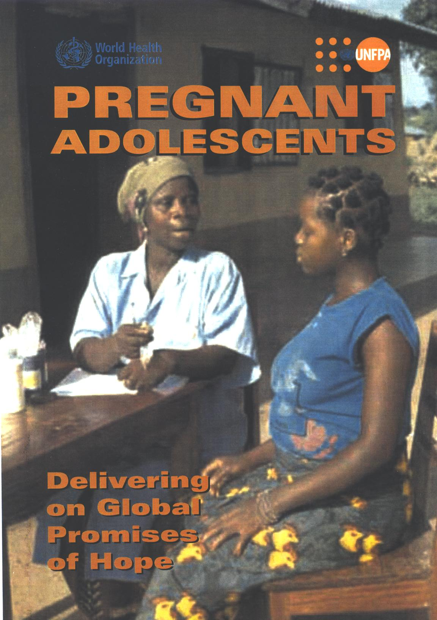
" For too long, when an adolescent becomes pregnant, we have pointed the finger at her. It is time that we pointed the finger at ourselves. If a girl gets pregnant that is because we have not provided her with the information, education, training and support she needs to prevent herself becoming pregnant."
Pramilla Senanayake,
Former assistance Director
International Planned Parenthood Federation.
APA YANG ANDA PIKIRKAN MENGENAI MASALAH INI?????
Is it public problem????
Notes:
27
Finally, we need to constantly bear in mind that pregnant adolescents do not bear the blame for their situation. Society and particularly adults have an enormous responsibility in providing adolescent girls the environment and means to protect themselves from unwanted and too early pregnancies.

Slide 28
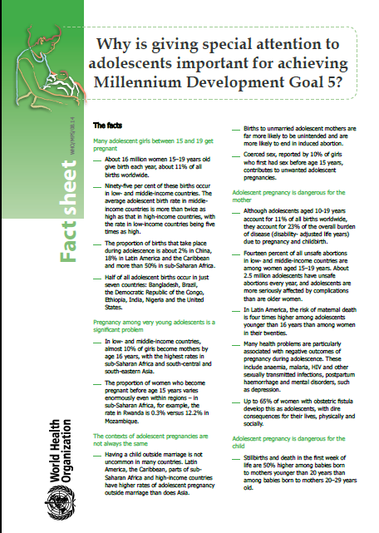
The relevance of adolescent pregnancy to the Millennium Development Goals (MDGs)
Adolescent pregnancy contributes to maternal mortality
Adolescent pregnancy contributes to perinatal and infant mortality
Adolescent pregnancy contributes to the vicious cycle of poverty.

Slide 29
The relevance of adolescent pregnancy to the Millennium Development Goals (MDGs)
Adolescent pregnancy contributes to maternal mortality
Adolescent pregnancy contributes to perinatal and infant mortality
Adolescent pregnancy contributes to the vicious cycle of poverty.
Addressing adolescent pregnancy is
Important for achieving the MDGs to reduce
poverty, childhood mortality & maternal mortality

Slide 30
KEHAMILAN USIA TUA

Slide 31
FASE PERKEMBANGAN MANUSIA
prakelahiran (prenatal period) | saat dari pembuahan hingga kelahiran.
Bayi (infacy) | kelahiran hingga 18 atau 24 bulan.
Awal anak-anak (early chidhood/ periode prasekolah) | masa bayi hingga usia lima atau enam tahun
Pertengahan dan akhir anak-anak (middle and late childhood/sekolah dasar) | 6 hingga 11 tahun, yang kira-kira setara dengan tahun-tahun sekolah dasar.
Masa remaja (adolescence) | 10 hingga 12 tahun dan berakhir pada usia 18 tahun hingga 22 tahun.
Awal dewasa (early adulthood) | usia 11 tahun atau awal usia 20 tahun dan yang berakhir pada usia 30 tahun.
Pertengahan dewasa (middle adulthood) | 35 hingga 45 tahun dan merentang hingga usia 60 tahun.
Akhir dewasa (late adulthood) | -usia 60 atau 70 tahun dan berakhir pada kematian.

Slide 32
PERTENGAHAN DEWASA (MIDDLE ADULTHOOD)
Bermula pada usia kira-kira 35 hingga 45 tahun dan merentang hingga usia 60 tahun.
Masa untuk memperluas keterlibatan dan tanggung jawab pribadi dan sosial seperti membantu generasi berikutnya menjadi individu yang berkompeten, dewasa dan mencapai serta mempertahankan kepuasan dalam berkarir.
Kekuatan fisik dan kesehatan mulai menurun

Slide 33
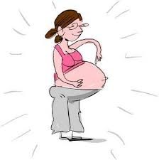
KEHAMILAN PADA USIA TUA
ELDERLY PRIMI: wanita yang sedang hamil pertama saat usia diatas 35 tahun.
Phenomena ”elderly primi” terus meningkat:
  Menikah lambat
  Menunda kehamilan untuk berkarier

Slide 34
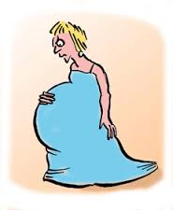
RESIKO & KOMPLIKASI
IBU:
Infertility
Spontaneous abortion
Gestational diabetes
Chronic hipertensi
Pre-eklamsia atau eklamsia
Preterm labor
Mulatiple pregnancy
Surgical birth
Plasenta previa
JANIN/BAYI:
Genetic disorder
Intra Uteri Growth Restriction (IUGR)
Low APGAR scores
(Bayrampour & Heaman, 2010)

Slide 35
RESIKO & KOMPLIKASI (1)
Abruptio placentae
the implanted placenta prematurely separates from the uterine wall. Associated with hypertension, trauma, increased amounts of amniotic fluid, multiples, and cocaine use.
Placenta previa
placenta is positioned close to or over the internal cervical os. Abnormal vascularization is thought to play a part. Associated with previous C-section, increased maternal age, and increased number of previous pregnancies.

Slide 36
RESIKO & KOMPLIKASI (2)
Preeclampsia
mother develops sustained HTN (systolic ≥ 140 mmHg or diastolic ≥ 90 mmHg) with proteinuria brought on by pregnancy, usually in the second half of gestation. It can affect many of the mother’s body systems, and can cause problems with the fetus by decreasing placental perfusion. Associated with previous miscarriage and the extremes of reproductive age.

Slide 37
RESIKO & KOMPLIKASI (3)
Eclampsia
usually occurs in a woman who has preeclampsia. The defining characteristic is convulsions not caused by a neurological disorder. Most cases occur within 24 hrs of delivery, but can happen up to 10 days after birth. Can cause maternal death.
Chronic hypertension
mother has HTN before the 20th week of gestation, or beyond 6 weeks after delivery. Usually caused by essential HTN, the risk for which increases with age. Increases risk of developing preeclampsia and eclampsia.

Slide 38
RESIKO & KOMPLIKASI (4)
Diabetes
type I, type II, or gestational diabetes can occur in pregnancy. Diabetes in pregnancy can lead to preeclampsia. It can also cause ketoacidosis and retinopathy in the mother. It can lead to congenital anomalies, IUGR, macrosomia (> 4000 g) which can cause problems in delivery, and can lead to a hypoglycemic neonate. Uncontrolled diabetes during pregnancy increases the risk of spontaneous abortion (< 20 wks) and stillbirth (≥ 20 wks). Type II diabetes may be a comorbidity in a mother of advancing age.

Slide 39
RESIKO & KOMPLIKASI (5)
Chromosomal abnormalities
may be due to the deteriorating quality of the ova with advancing age (Heffner, 2004).
  Types of abnormalities:
    Down syndrome (trisomy 21)
    Edwards syndrome (trisomy 18), dll
  Each of these chromosomal abnormalities causes different characteristic changes of the fetus, various mental changes, and altered life expectancies of the neonate.
  The incidence of Down syndrome among all newborns is about 1:800. For mothers age 35, the incidence is 1:385, and for mothers age 45, the incidence is 1:33 (Beckmann et al., 2006).
  Men with advancing paternal age also have an increased risk of producing a child with an autosomal dominant disease, like Marfan syndrome, because of increased genetic mutations (Heffner, 2004).

Slide 40
RESIKO & KOMPLIKASI (6)
Infertility
can be caused by maternal issues associated with age such as premature ovarian failure, perimenopause, and menopause. Can also be due to anovulation, anatomical defects, or a variety of other problems in the female. May also be due to abnormal spermatogenesis in the male.

Slide 41
BOLEHKANH KEHAMILAN ELDERY PRIMI?????
YA TIDAK
SOLUSI
Kehamilan yang terencana
Reguler Prenatal Care
Makan healthy diet
Kenaikan BB diatur
Tetap beraktivitas
Screening untuk gangguan Genetic
√

Slide 42
KESIMPULAN
RELATIONSHIP BETWEEN MATERNAL AGE AND PERINATAL OUTCOMES
Rigorous study in Latin American & the Caribbean showed that:
  Adolescent mothers had higher risks of regular & very preterm delivery, & of giving birth to infants that were low & very low birth weight, as well as small for gestational age (compared to women aged 20-34)
  Infants born to women below 16 years faced a 50% increase in risk of early neonatal death
  All risks increased as maternal age decreased
08_XXX_MM42
Source: Conde-Agudelo, Belizán & Lammers, 2005
Notes:
Babies born to adolescent mothers faces also risks: As we can see, an important good quality study have shown that there is an important relationship between maternal age and perinatal outcomes.

Slide 43
KEHAMILAN DENGAN OBESITAS

Slide 44

FAKTA OBESITAS
Pada tahun 2013:
DUNIA
Orang dengan kegemukan di dunia berjumlah 2,1 miliar
negara maju yang gemuk kebanyakan adalah laki-laki
INDONESIA
Indonesia masuk urutan 10 besar dengan orang kegemukan berjumlah 40 juta orang atau setara seluruh penduduk jawa barat
Indonesia yang gemuk kebanyakan adalah PEREMPUAN

Slide 45


OBESITAS
OBESITAS: lemak tubuh yang menumpuk sehingga Body Mass Index (BMI) lebih dari 30 kg/m².
BMI $=\frac{BB}{{TB}^{2}}$
BMI | KATEGORI
< 18.5 | Berat badan kurang
18,5-22,9 | Berat badan normal
≥23.0 | Kelebihan berat badan
23.0-24.9 | Beresiko obesitas
25.0-29.9 | Obesitas I
≥30.0 | Obesitas II
OBESITAS:
Meningkatkan masalah kesehatan.
Menurunkan angka harapan hidup.
(center of obesity research and education, 2007)

Slide 46
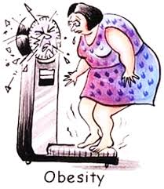
KENAIKAN BB SELAMA HAMIL
KATEGORI STATUS NUTRISI | PENAMBAHAN BB
UNDERWEIGHT (BMI <18.5) | 28-40 pound
NORMAL WEIGHT (BMI 18.5-24.9) | 25-35 pound
Overweight (BMI 25-29.9) | 15-25 pound
Obese (BMI >30) | 11-20 pound
Beresiko melahirkan bayi BBLR
IMO, 2009; IMO, 2010

Slide 47
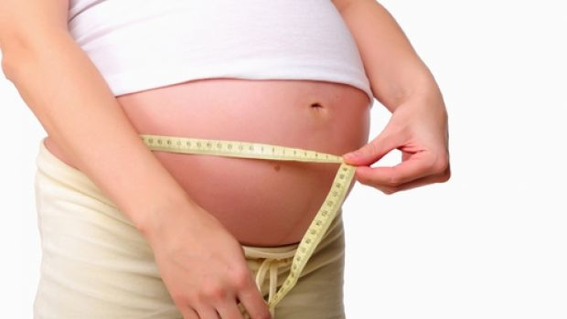
KEHAMILAN DENGAN OBESITAS (KO)
Kelebihan jaringan lemak yang ada dalam tubuh dapat meningkatkan over produksi hormon estrogen
Sekitar 10 persen perempuan yang kesulitan hamil disebabkan oleh PCOS (polycystic ovarian syndrome).

Slide 48

DAMPAK DARI KO
Gestational Diabetes
Hipertensi
Fetal Macrosomia
High risk Post partum infection
Post date
High risk SC
Meningkatkan resiko maternal mortaliy
High risk Post partum Hemorrhagic
(Hull, Montgomery, Vireday, & Kendall-Tackett, 2011)

Slide 49
RESIKO & KOMPLIKASI
IBU
BAYI/JANIN
    Miscarriage
    Thromboembolism
    Gestational diabetes
    Pre eclampsia
    Dysfunctional labour
    Caesarean section
    Wound infection
    Anaesthetic complications
    Maternal mortality
    Congenital malformation
    Fetal macrosomia
    Shoulder dystocia
    Stillbirth
    Neonatal death
    Neonatal morbidity i.e. NICU admission
    Reduced rates of breast feeding

Slide 50
MANAGEMENT KO (1)
Optimise weight before pregnancy
  Educate & advise all women with BMI>30 to lose weight before conception
  Weight loss >4.5 Kg before pregnancy reduces the risk of gestational diabetes by 40%
Dietary Supplementation
  Folic acid 5 mg/day for -1 to +3 months of pregnancy
  Vitamin D 10 ug/day (? Required for a sun-loving Aussie)
Measure and calculate BMI at first ANTENATAL CARE
  Preferably before 12w
  Don’t rely on self estimates of height & weight
Dietary Advice

Slide 51
MANAGEMENT KO (2)
Recommend daily physical activity & reinforce
Provide detailed, accurate and specific pregnancy risk advise to all women with BMI>30
Women with BMI>35 need obstetrician-led Delivery Unit
Discuss & document intrapartum risks and plans management
Induction of delivery only for obstetric indications
Requests for VBAC require individual assessment
IV access in labour
Active management third stage
Subcutaneous suture if Caesarean is required
Special education and support for breastfeeding should begin antenatally
Encourage postnatal weight loss or refer

Slide 52
TERIMAKASIH

